Slide 1
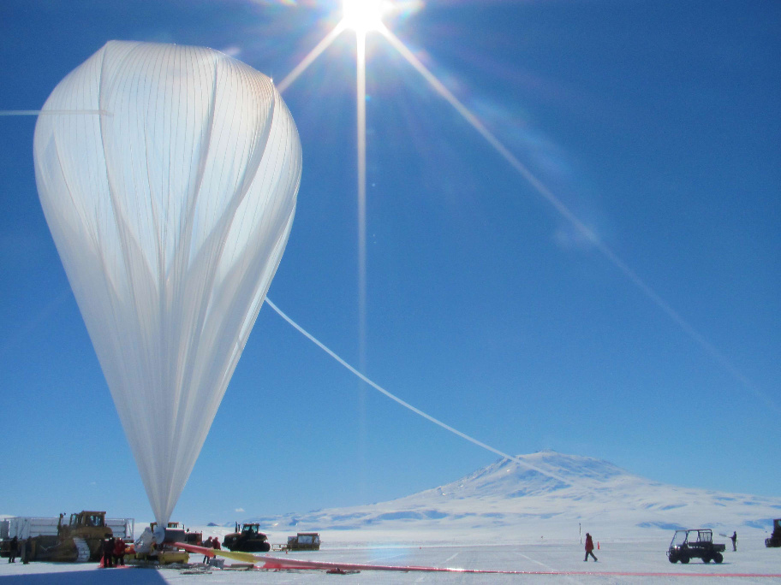
Lighter-than-air Aviation
C/TSgt Blanco
Learning Goals:
Aerostatics: buoyancy minus weight = LIFT!
Applications:
Hot-air balloons – demonstration outdoors
Gas balloons and dirigible airships
Activities:
Neutral buoyancy challenge
Pylon race
Finish quiz / Q&A

Slide 2
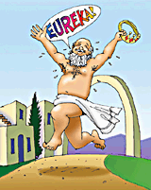
Buoyancy: Archimedes Principle
“The buoyant force of a fluid on an object is equal to the weight of fluid displaced.”
- acts upwards, opposite to gravity
Any object in air has a buoyant force on it, but…for a net LIFT force on object, it must displace more air than it weighs, i.e. be “lighter than air”.
Air
Helium
Q. Is there a buoyant force acting on YOU right now?
weight
Buoyancy
Buoyancy
weight

Slide 3
From Archimedes:
Buoyant force (lb)
= outside fluid density (lb/cu. ft.) x Volume (cu. ft.)
- depends only on VOLUME of object and DENSITY of outside fluid, nothing to do with object’s weight!
E.g. At sea level, outside air density is ~ 0.075 lb/cu. ft. , so to lift 100lb, must displace at least ~1300 cu. ft. of air!
Q. Is there more buoyant force on an object…
…at high or low altitude?
…on a hot or a cold day?
Hint: think about the density of the surrounding air
Q. If the weight of entire balloon (i.e. the gas inside, envelope, payload) is less than that of the air volume displaced, it must ___________. (ascend / descend / float level)

Slide 4
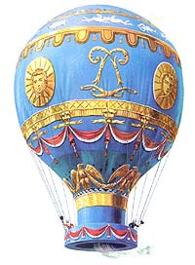
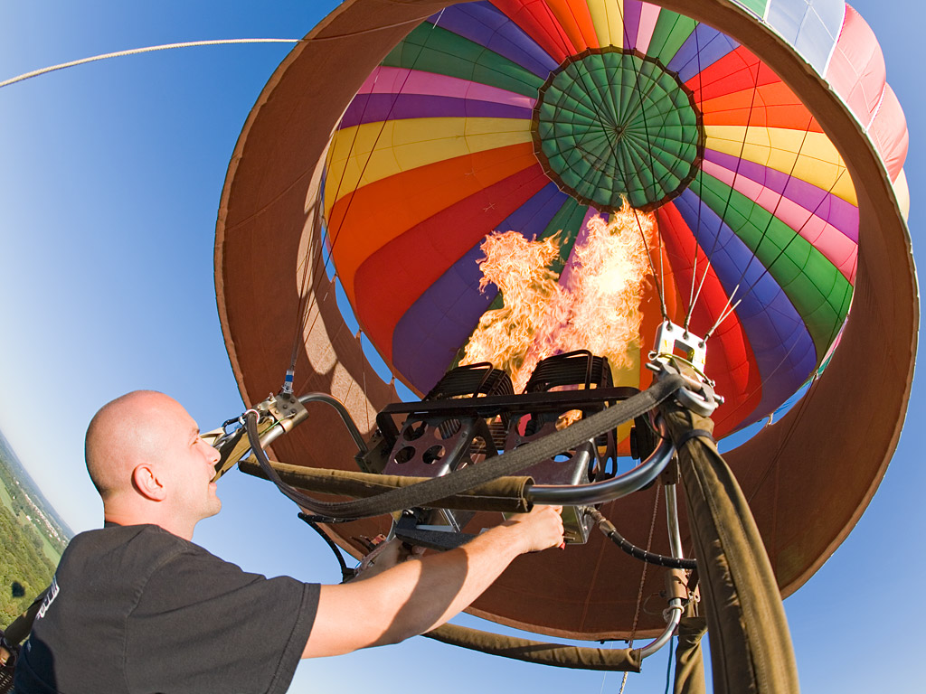
Hot-air Balloons (demonstration)
Warm air less dense, lighter than displaced weight of surrounding cold air - causing it to rise upwards.
1783 Montgolfier brothers (Paris): first hot-air balloon flights with sheep, rooster, duck
- first free human flight, lasted 25 minutes, 5 miles.
Today, cheap safe PROPANE fuel heats air inside balloon, making it less dense than air outside.
1000 cubic feet (e.g. a 10ft cube) of hot air can only lift ~ 25 pounds
Some control over ascent/descent via burners or “parachute panel” air release valve at the top
Used to fly all over the world

Slide 5
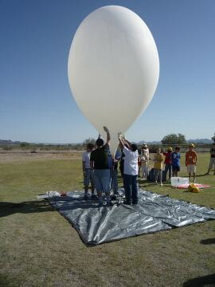
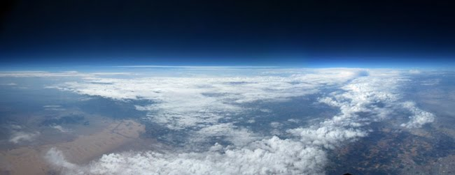
Hydrogen or Helium balloons For net lift, gas must be less dense than surrounding air
U.S. Civil War through WW1: tethered hydrogen balloons used for observation
Hydrogen (H₂) – gives most lift but highly FLAMMABLE!
Helium (He) – almost as much lift, inert, but $$$
1000 cubic feet (10ft cube) of either gas can lift ~ 60-70 pounds at sea level
TODAY: Only helium deemed safe for use.
Small weather balloons sent up to near space (burst altitude ~ 30 km)

Slide 6
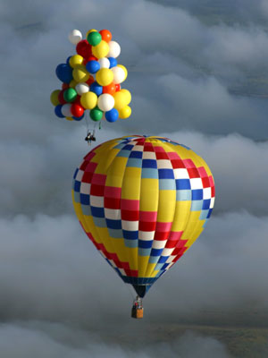
“Cluster” helium balloon (above) and hot air balloon (below): Each must displace a volume of air at least equal to weight of the entire craft (including envelope, payload, gas inside)

Slide 7
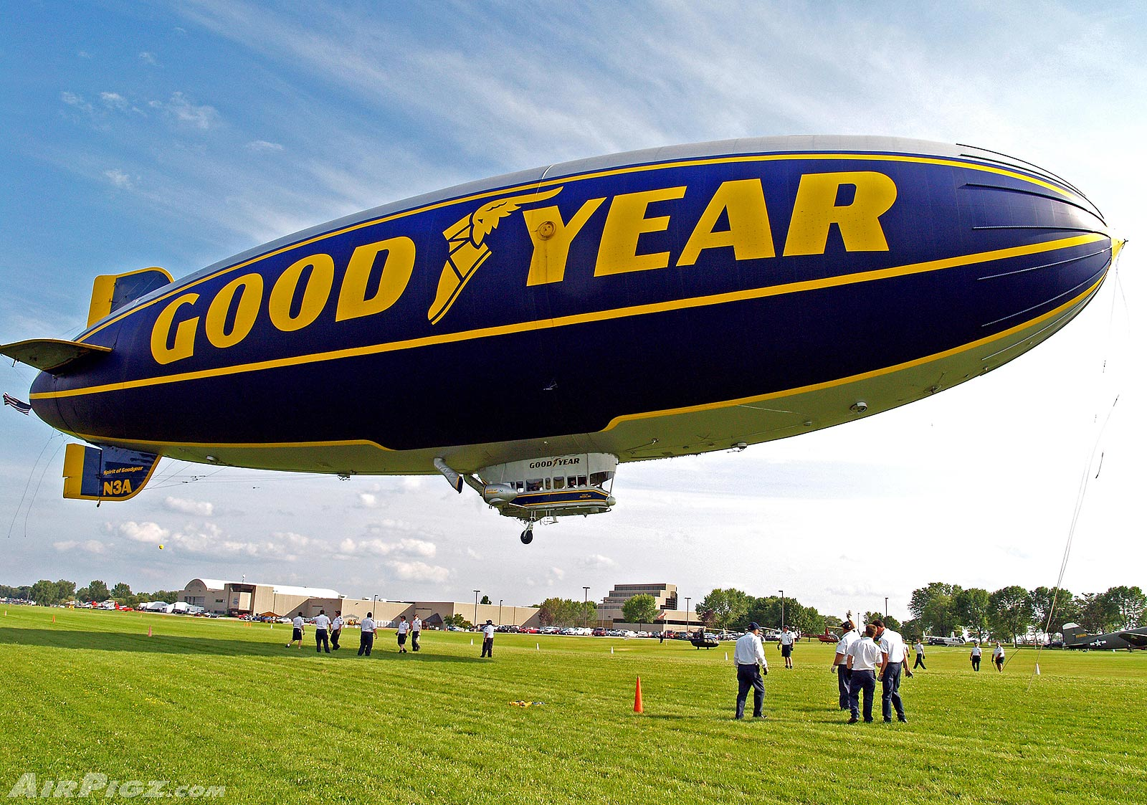
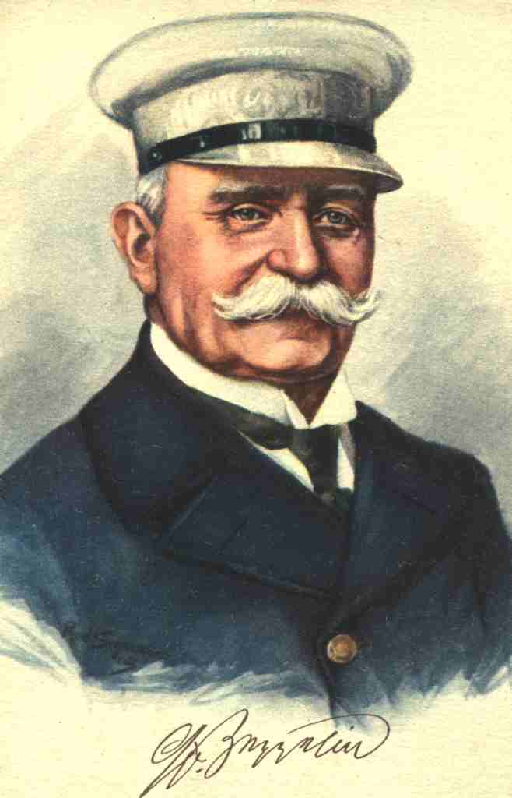
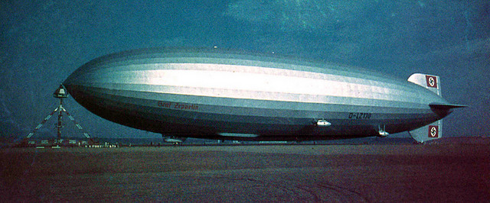
Dirigible airships
1900s: Desire for DIRIGIBLE (steerable) airships, 2 kinds:
RIGID AIRSHIP: developed by Count Ferdinand von Zeppelin:
“Skeleton” frame holding gas bags, covered by fabric “skin”
Used in WW1 (bombing), then transatlantic flights up to WW2
(Graf Zeppelin and Hindenburg), some U.S. Navy trials.
NON-RIGID AIRSHIP (“BLIMP”) –
keeps shape due to gas pressure inside airtight rubberized envelope
Both have elevators, rudders, engines, air chambers to change weight in flight (don’t want to release any gas!), ballast weight.
“Hydrogen age” ended with the Hindenburg disaster (1937).
Helium airships/balloons can stay aloft for days, quiet operation, used for sporting events, advertising, border observation

Slide 8
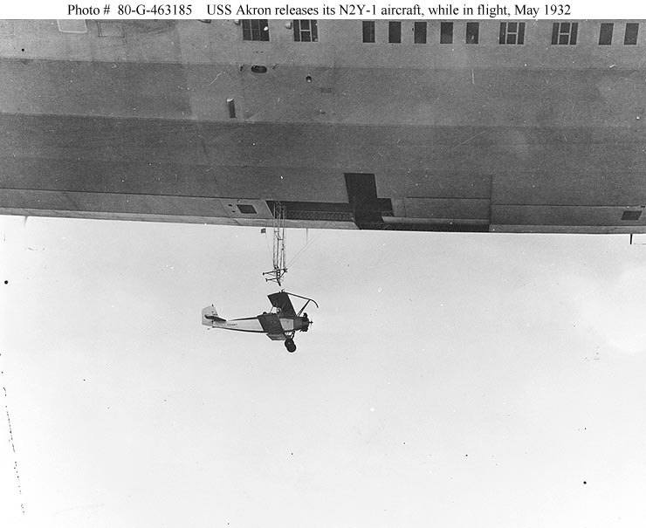
U.S. Navy experiments with rigid airship as aircraft carrier, 1932

Slide 9
Indoor Activities
In teams (no more than 1 BTF and 1 line staff per team):
Neutral buoyancy challenge:
1. Get: cup+ribbon+clip, helium-filled balloon, tube of M&Ms
2. Without removing clip, estimate by feel how many M&Ms your balloon could carry…
----------------------- STOP! -----------------------
3. When instructed, remove clip and hold on to cup
All teams release balloons together!
4. Try again – change payload to get close to neutral buoyancy.
Pylon race: add small amount of extra weight to cup
THE RULE: no-one may touch any part of your balloon or payload assembly.
Timed round-trip around our two human pylons.

Slide 10
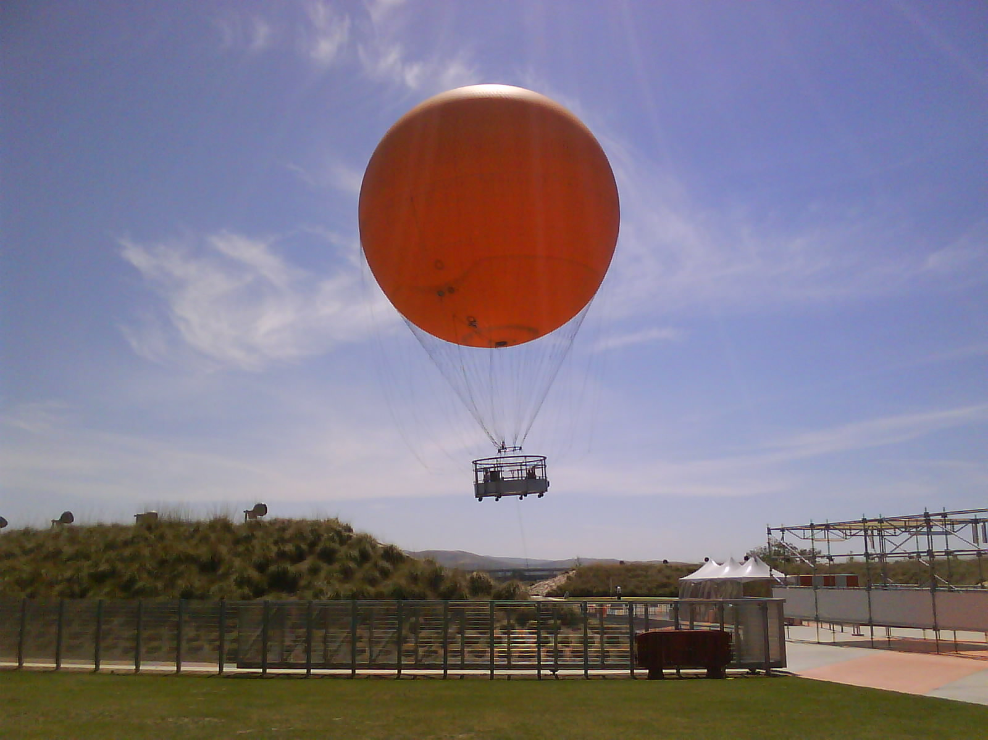
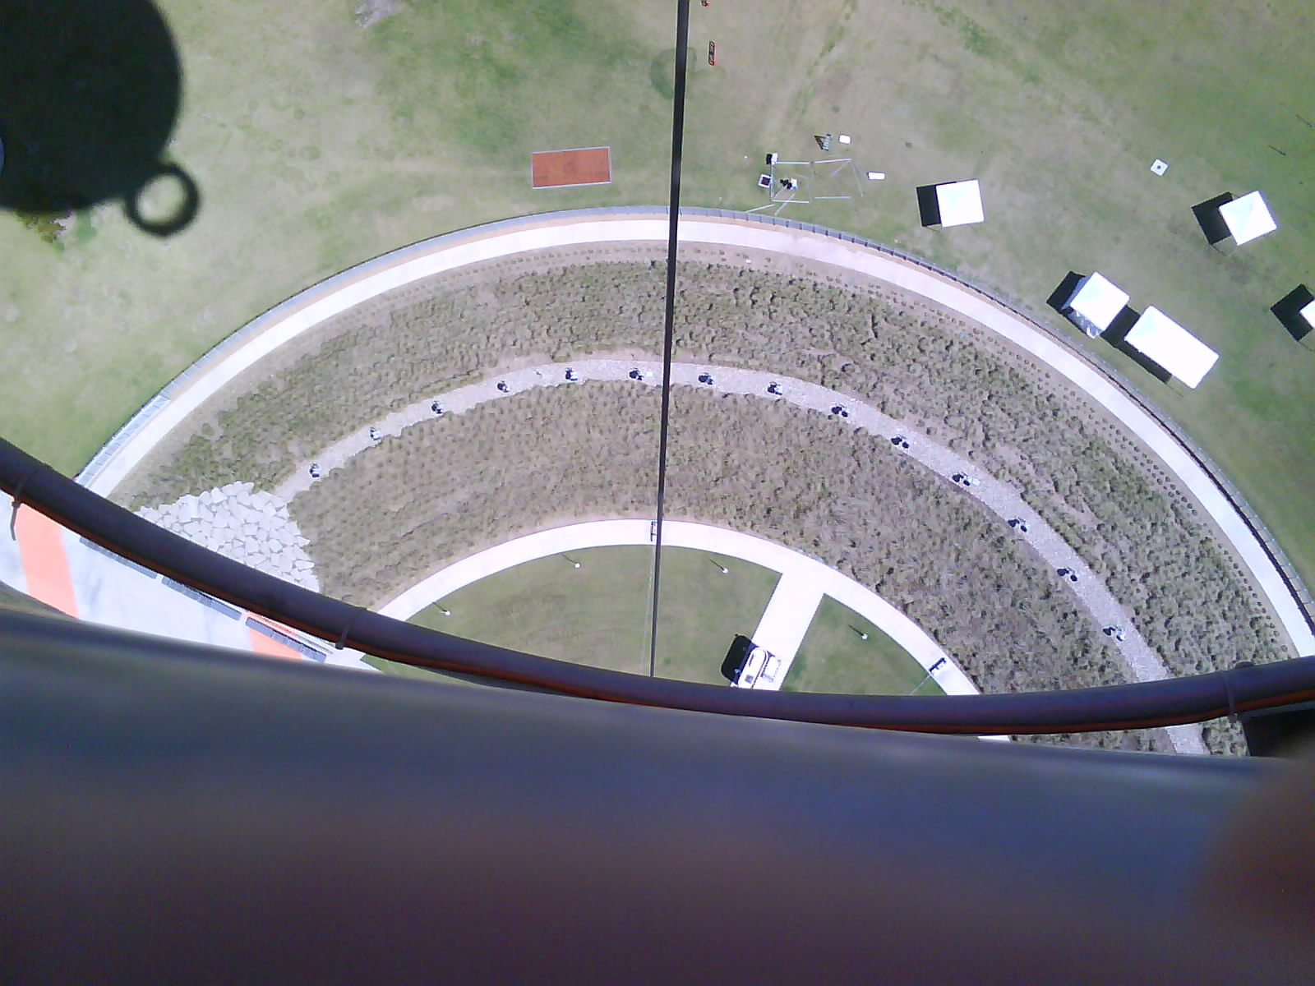
Orange County Park Balloon: a tethered helium aerostat
(similar one at the San Diego Safari Park)
Diameter = 22.4 m
Air density = 1.2 kg/m³
Helium density =0.18 kg/m³
Deflated mass 900 kg

